Slide 1
the interchain cometh!
the radical implications of having every blockchain inside the DeFi and dapp ecosystem

Slide 2

the interchain cometh!
arlyn culwick
the blocknet

Slide 3
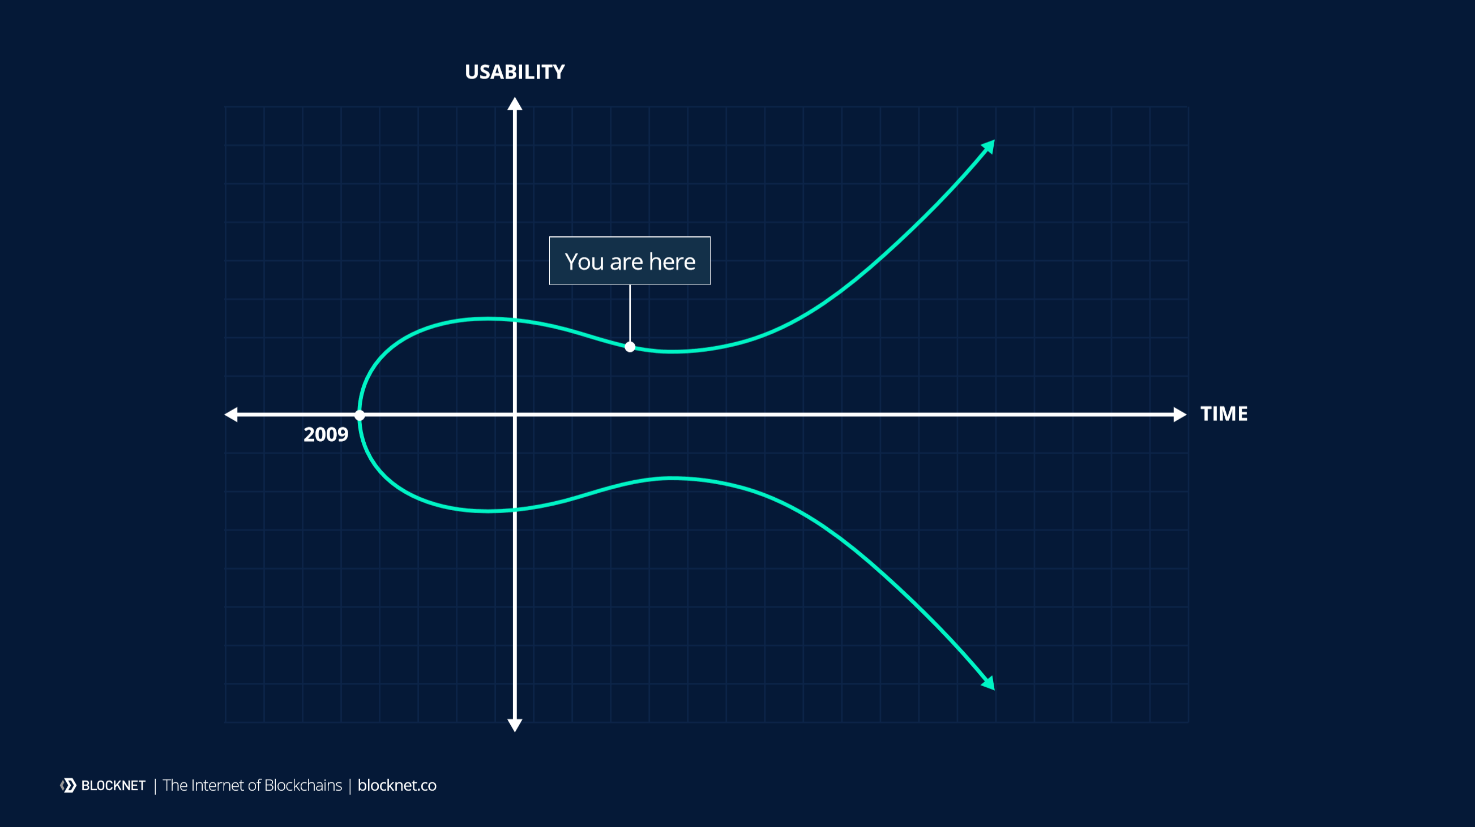

Slide 4
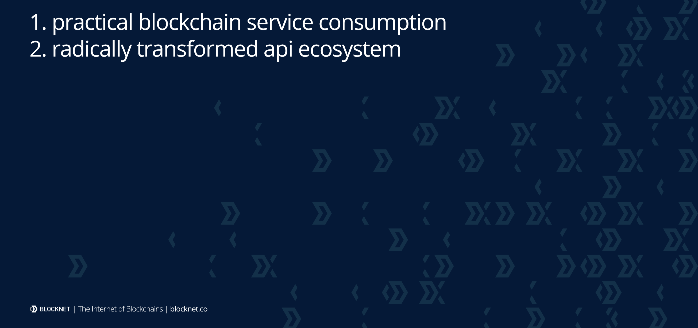
an emerging technology epoch

Slide 5
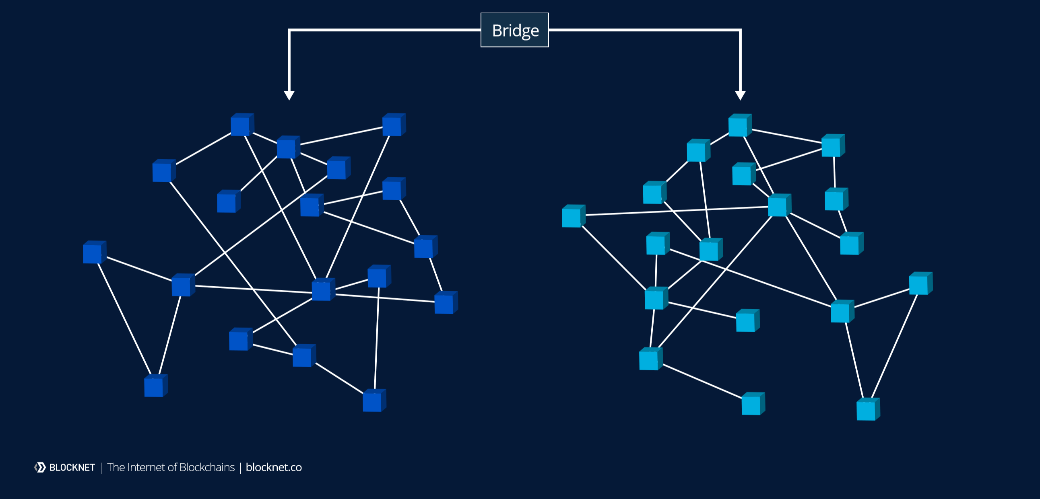
interchain communication

Slide 6
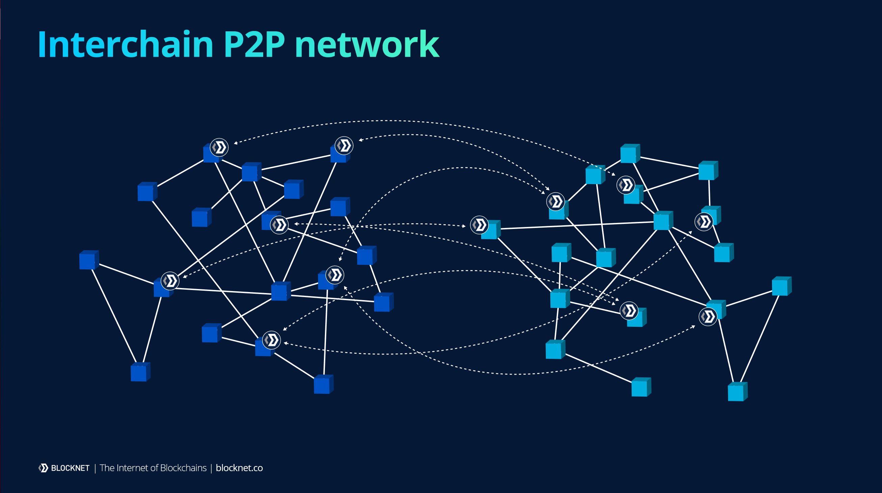
interchain p2p network

Slide 7
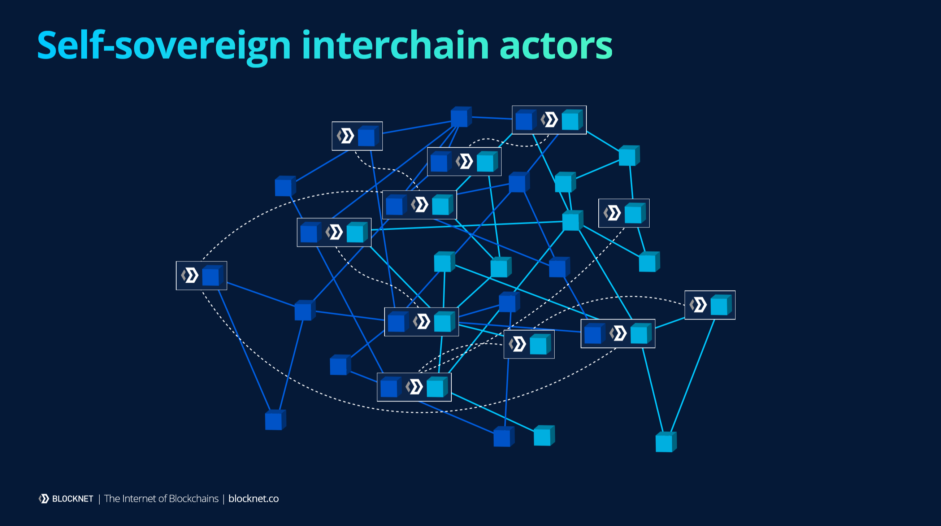
self-sovereign interchain actors

Slide 8
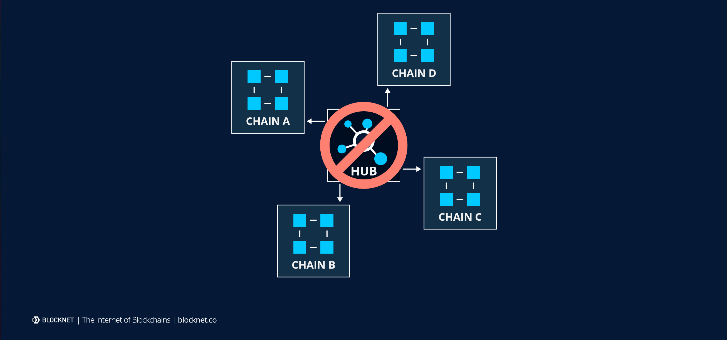
blockchain ≠ interchain

Slide 9
the edges of the interchain
mobile phone
blockchain
centralized service

Slide 10
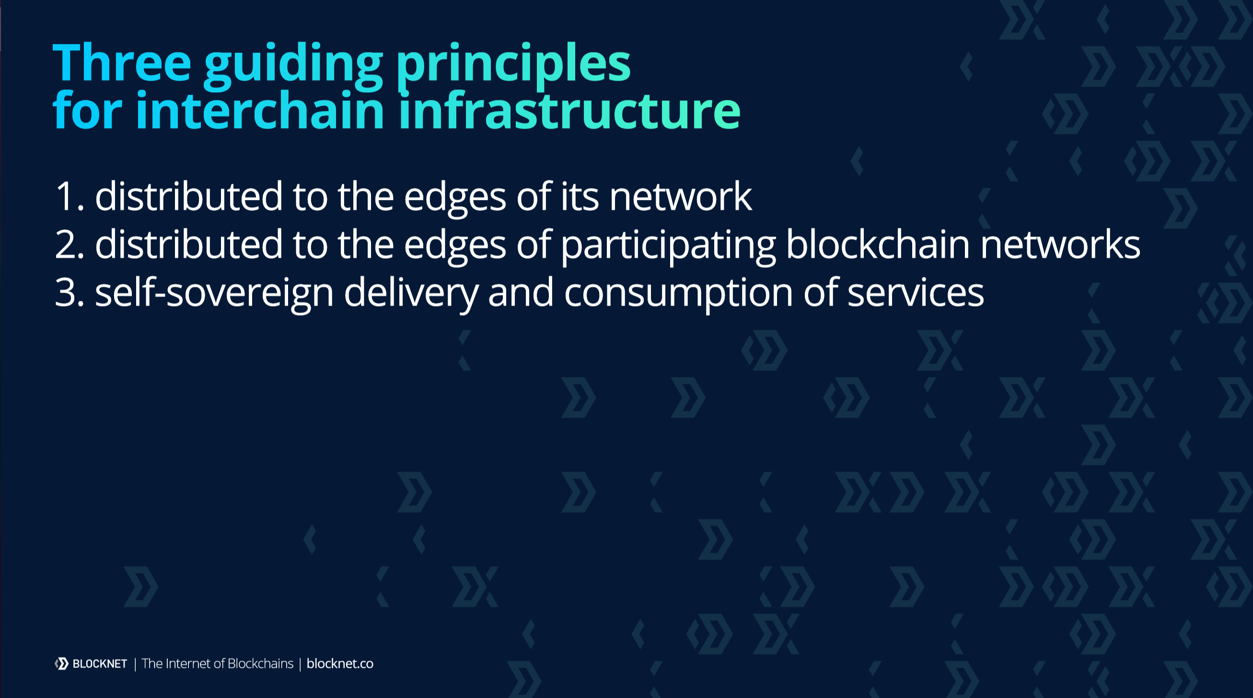
defining concepts

Slide 11
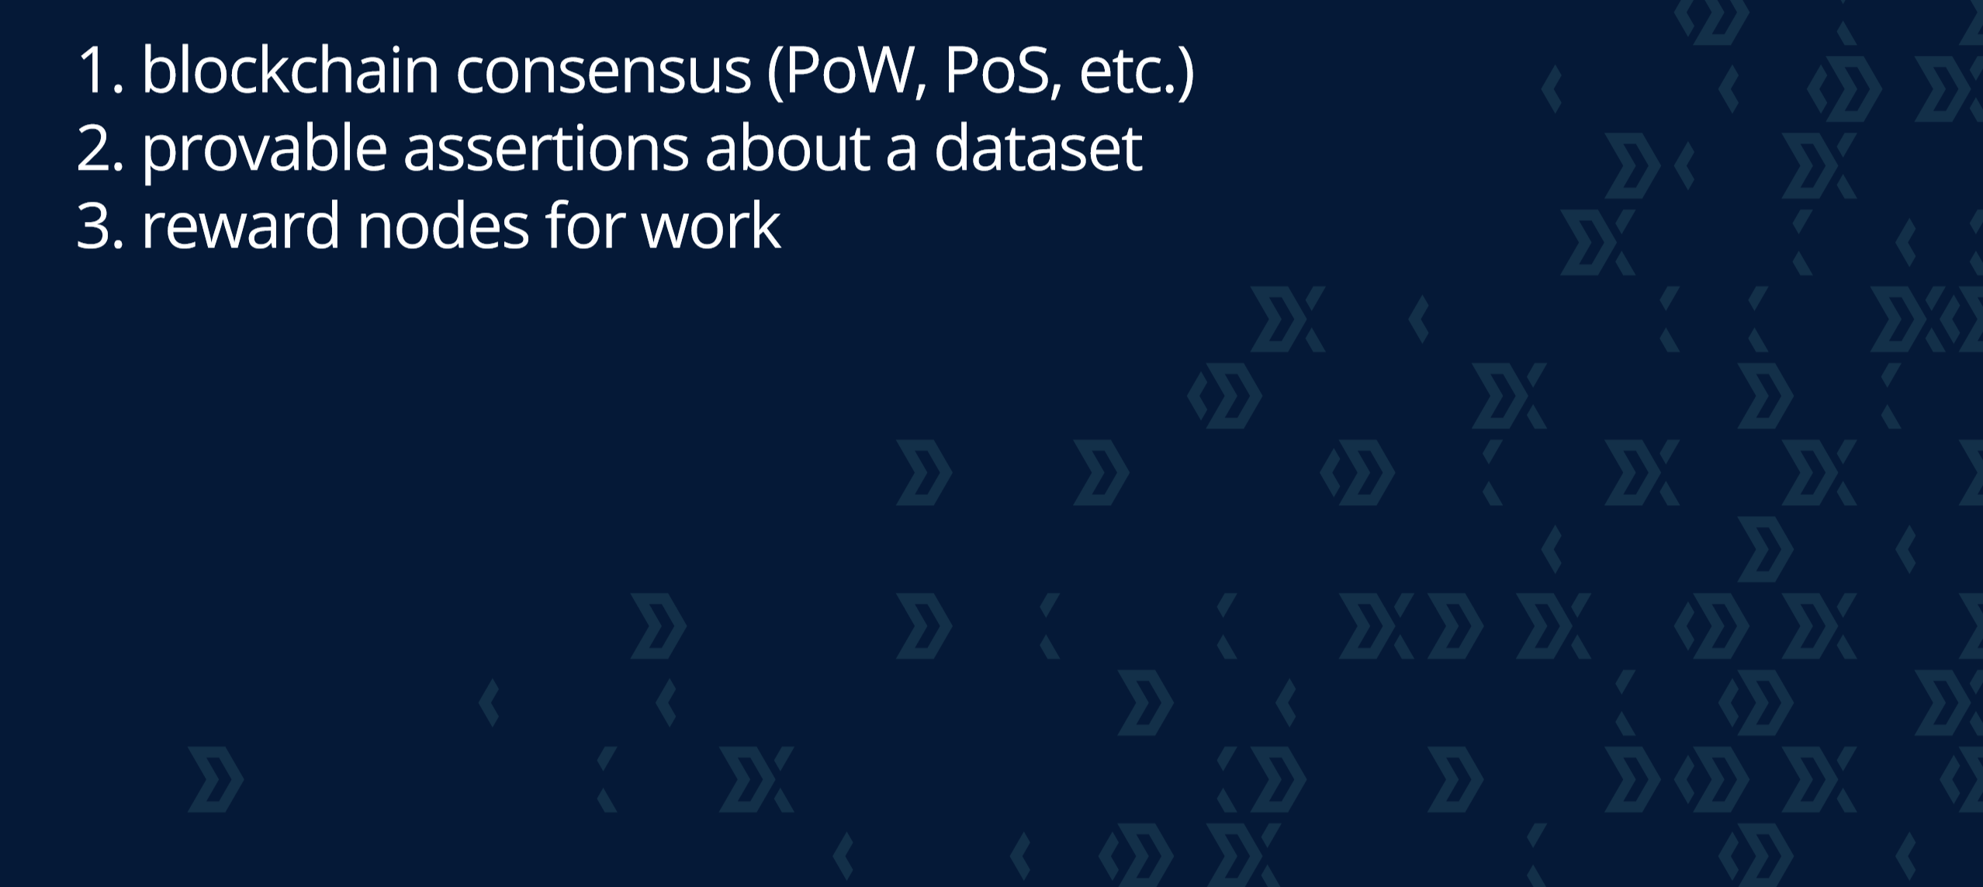
why do we need interchain dapps?
examples:
trustless BTC peg on ETH
decentralized storage dapp
registry of interchain services

Slide 12
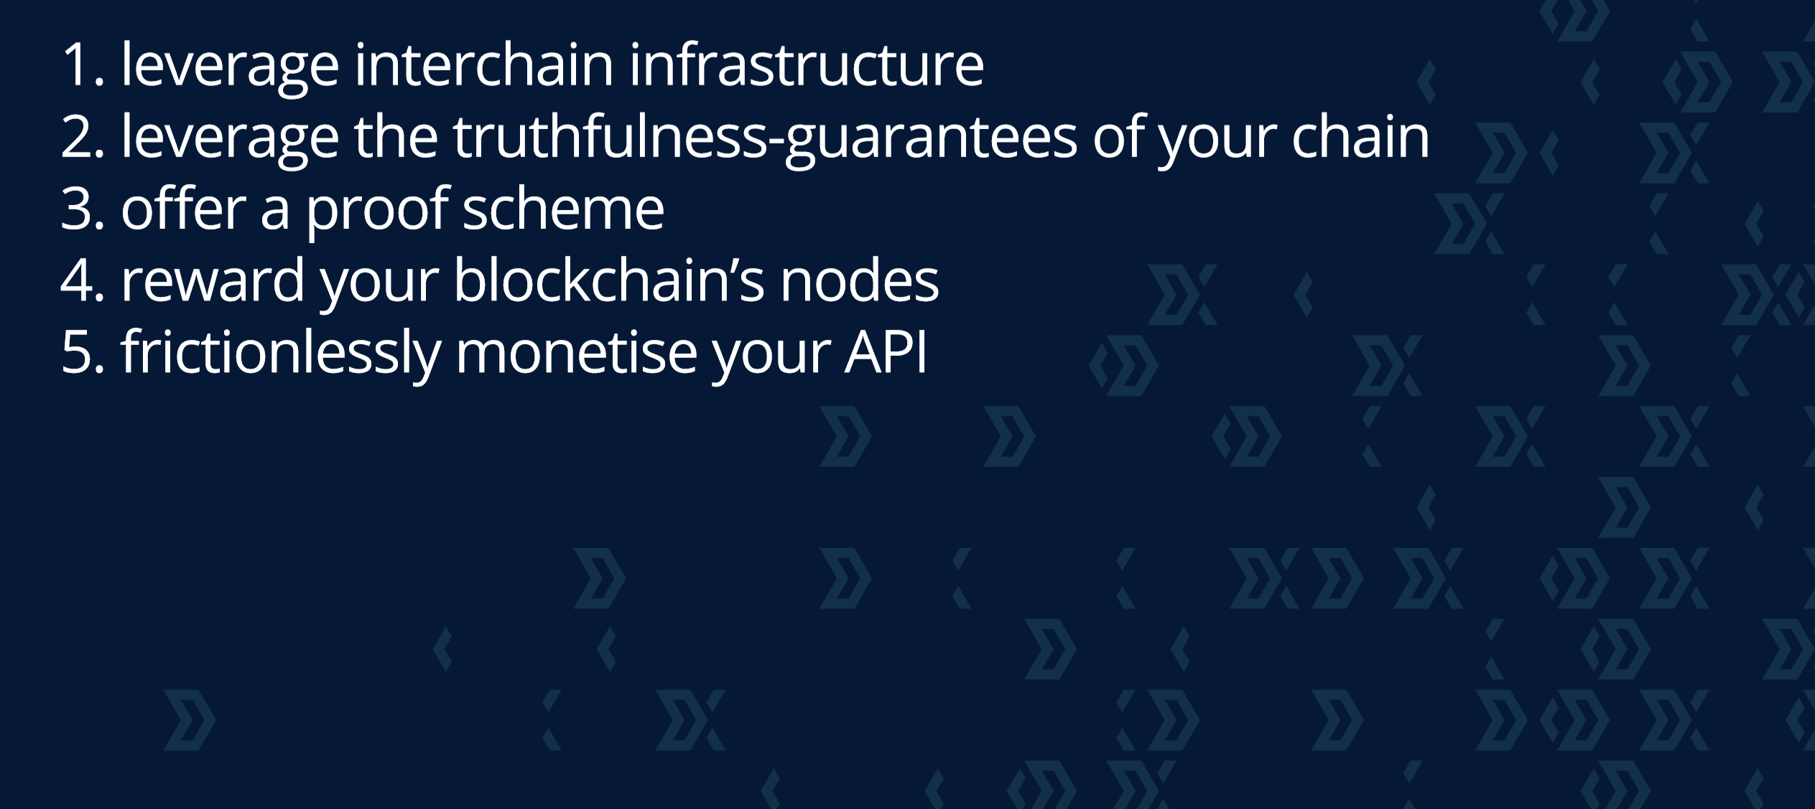
why are interchain dapps better?
ecosystem benefit: leverage existing contracts/features on any blockchain
save dev time: leverage existing interchain infrastructure and proof schemes (e.g. SPV)
no rent-seeking: leverage existing PoW/PoS to reward work
double as a SaaS through decentralized APIs
actual dev work required: just orchestration and UX!

Slide 13
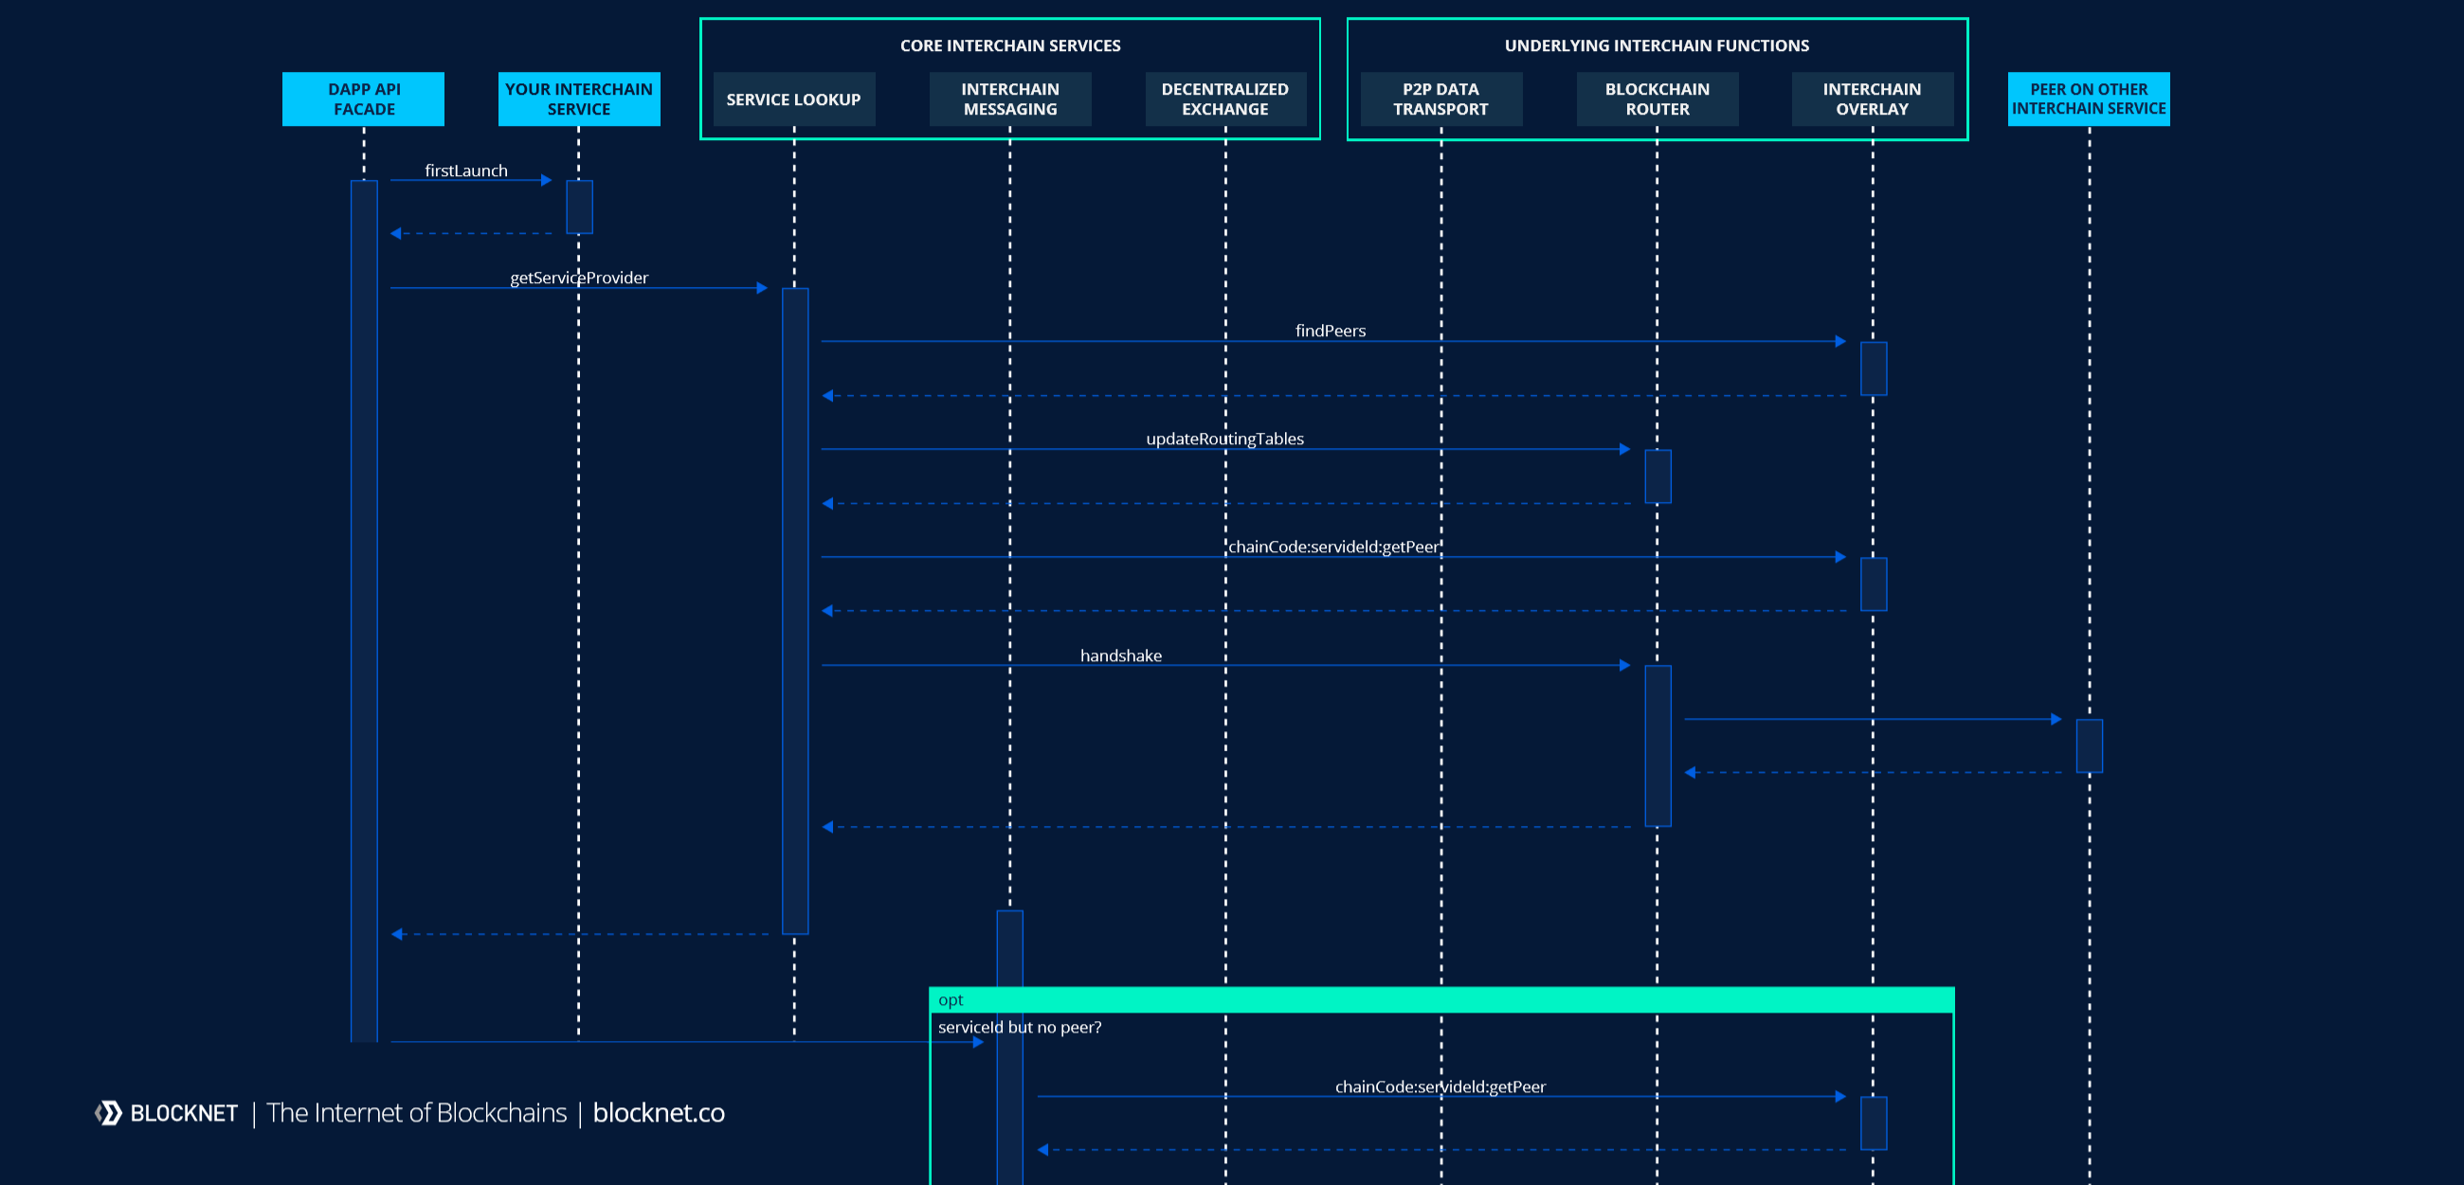
offload complexity & frictionlessly monetise

Slide 14
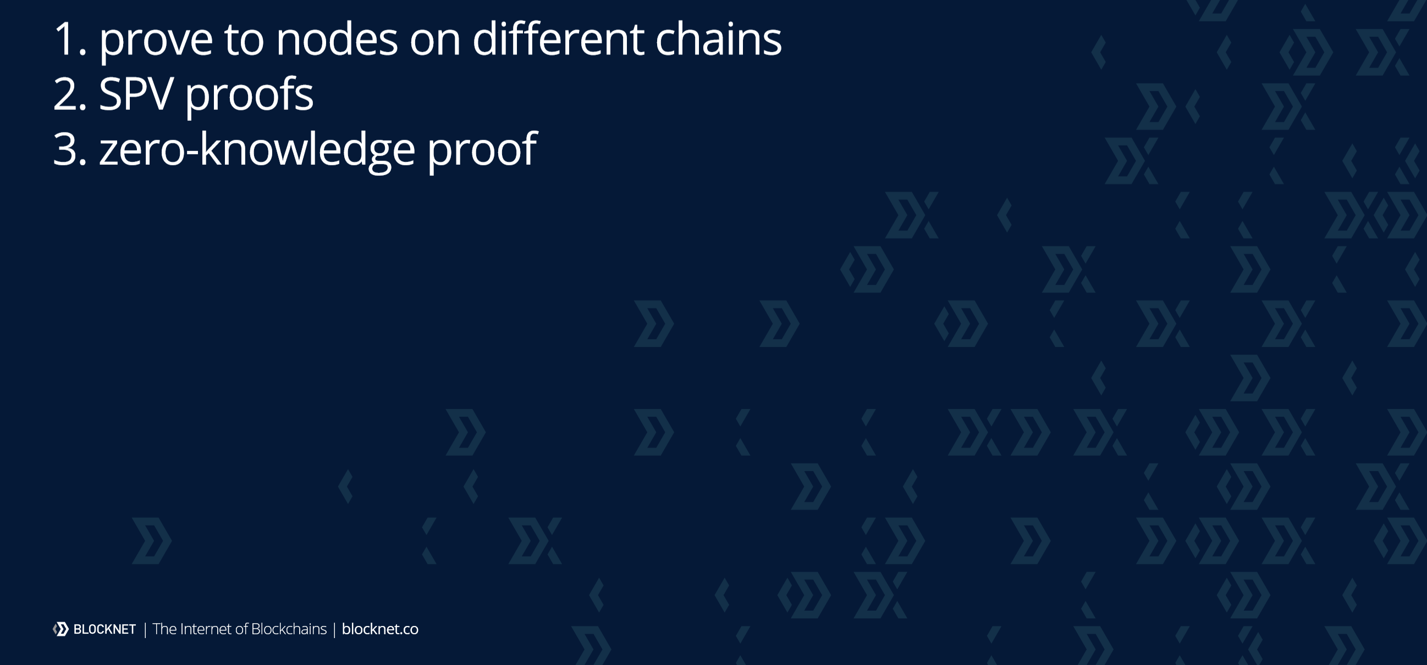
demo
it exists!
api.blocknet.co

Slide 15
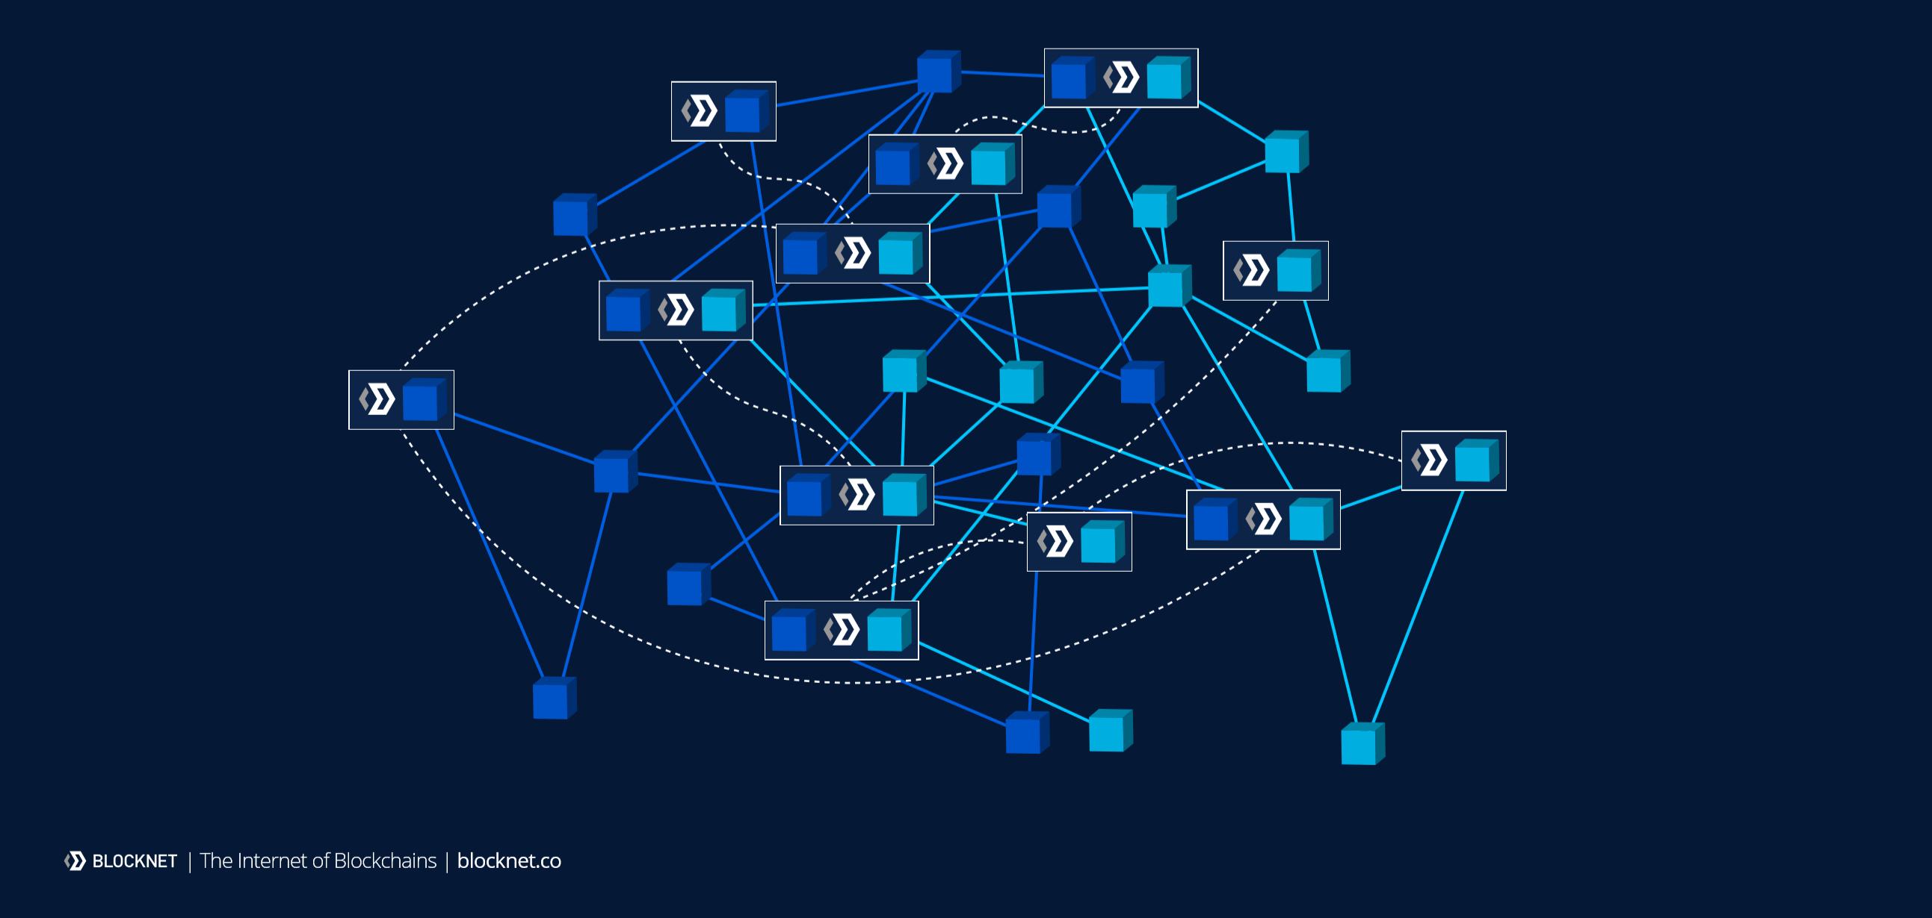
DeFi and the internet of value

Slide 16
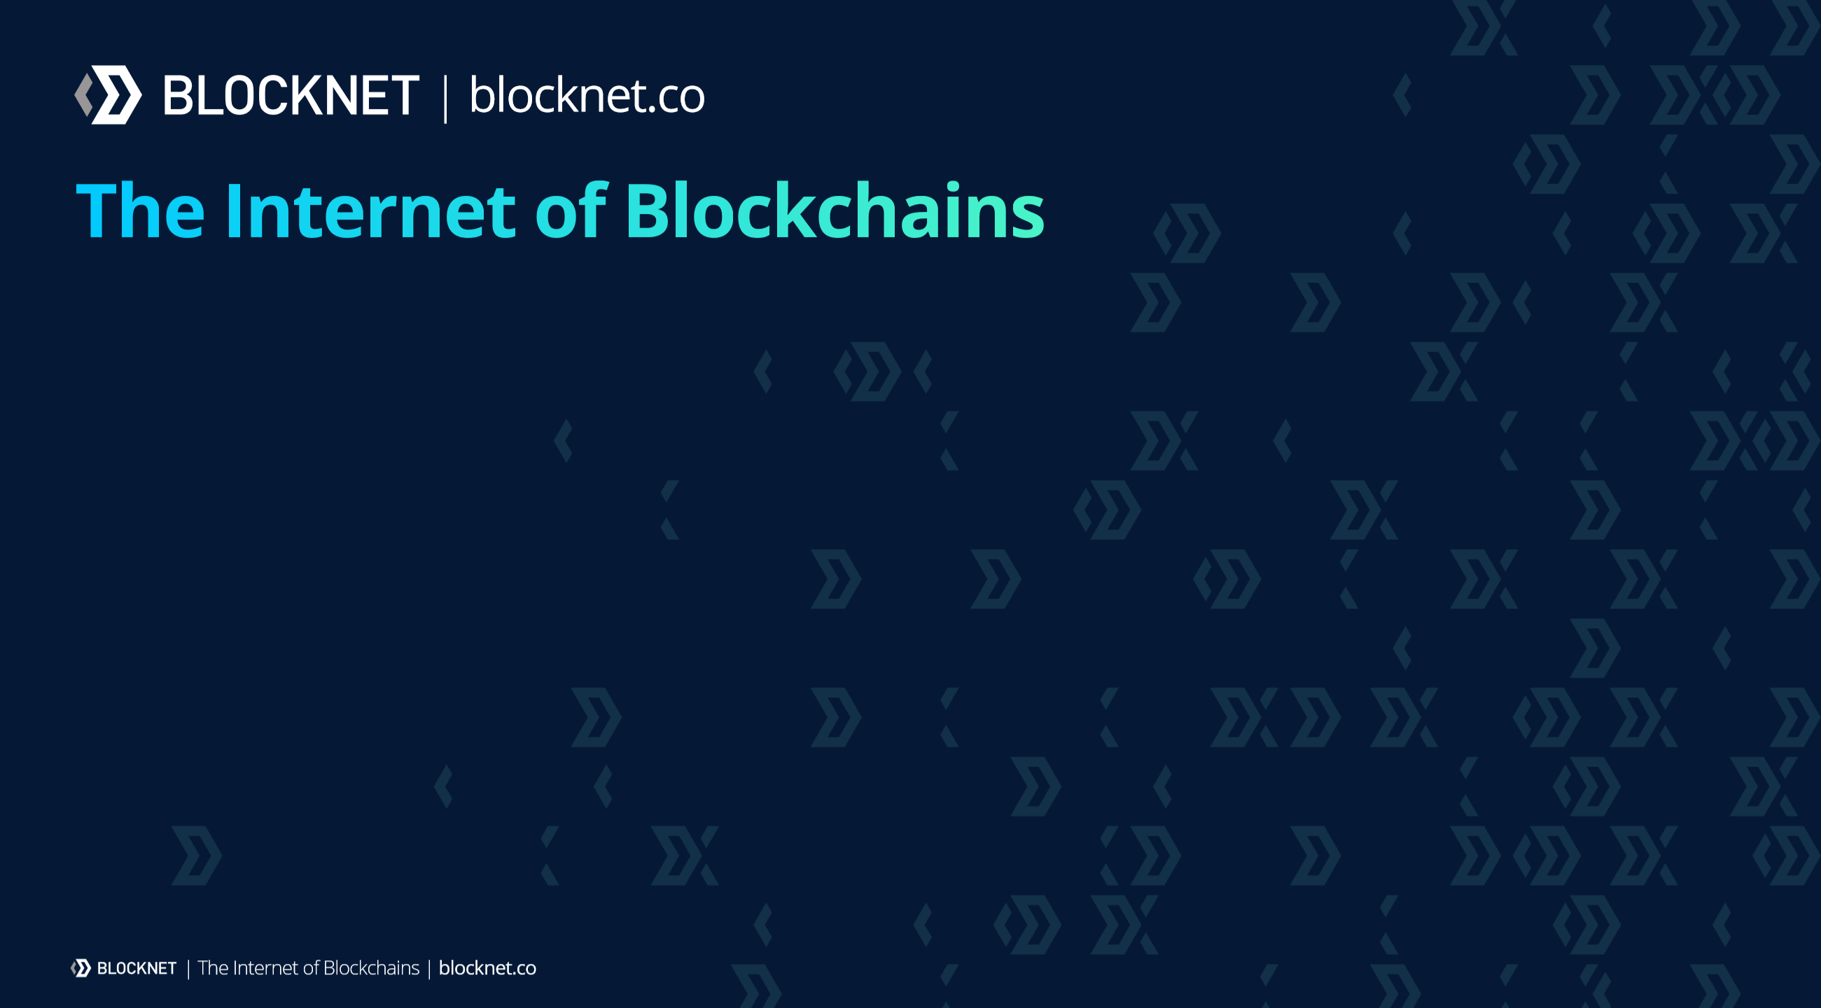

arlynculwick@blocknet.co
**devs wanted**

